Slide 1

SSL and TLS

Slide 2
SSL/TLS

Slide 3
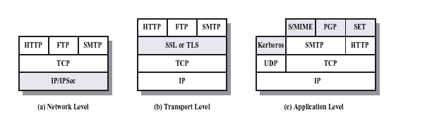
Layers of Security

Slide 4
What is SSL / TLS?
Transport Layer Security protocol, ver 1.0
De facto standard for Internet security
“The primary goal of the TLS protocol is to provide privacy and data integrity between two communicating applications”
In practice, used to protect information transmitted between browsers and Web servers
Based on Secure Sockets Layers protocol, ver 3.0
Same protocol design, different algorithms
Deployed in nearly every web browser

Slide 5
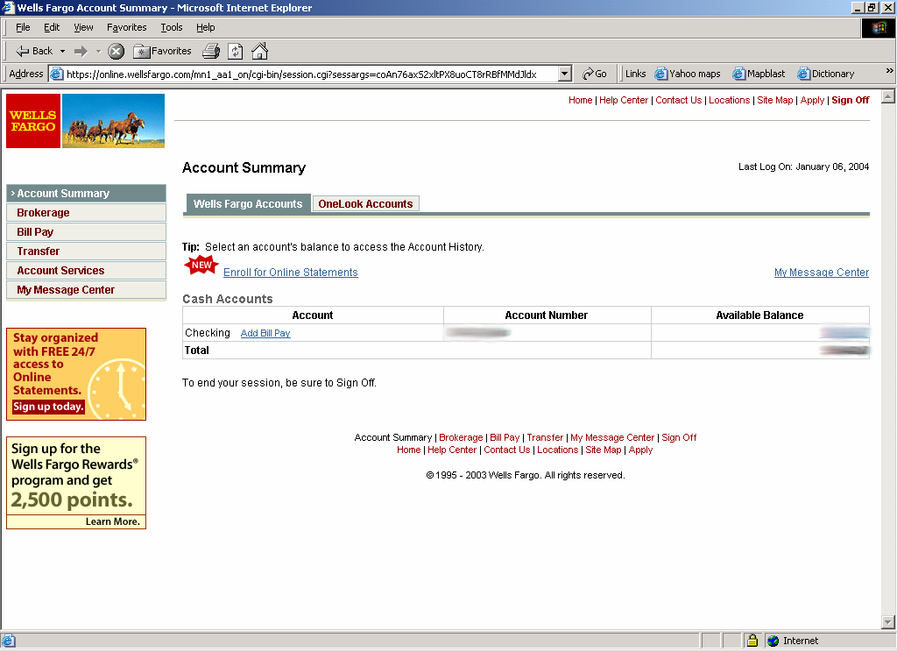
SSL / TLS in the Real World

Slide 6
History of the Protocol
SSL 1.0
Internal Netscape design, early 1994?
Lost in the mists of time
SSL 2.0
Published by Netscape, November 1994
Several problems (next slide)
SSL 3.0
Designed by Netscape and Paul Kocher, November 1996
TLS 1.0
Internet standard based on SSL 3.0, January 1999
Not interoperable with SSL 3.0

Slide 7
SSL 2.0 Vulnerabilities
Short key length
In export-weakened modes, SSL 2.0 unnecessarily weakens the authentication keys to 40 bits.
Weak MAC construction
Message integrity vulnerability
SSL 2.0 feeds padding bytes into the MAC in block cipher modes, but leaves the padding-length unauthenticated, may allow active attackers to delete bytes from the end of messages
Ciphersuite rollback attack
An active attacker may edits the list of ciphersuite preferences in the hello messages to invisibly force both endpoints to use a weaker form of encryption
“Least common denominator" security under active attack

Slide 8
Let’s get going with SSL/TLS …
Informal
Protocol
Description
Formal
Protocol
Intruder
Model
RFC
(request for
comments)
Analysis
Tool
Find error

Slide 9
Request for Comments
Network protocols are defined in an RFC
TLS version 1.0 is described in RFC 2246
Intended to be a self-contained definition of the protocol
Describes the protocol in sufficient detail for readers who will be implementing it and those who will be doing protocol analysis (that’s you!)
Mixture of informal prose and pseudo-code
Read some RFCs to get a flavor of what protocols look like when they emerge from the committee

Slide 10
From RFC to Murj Model
Informal
Protocol
Description
Formal
Protocol
Intruder
Model
Murj code
RFC
Analysis
Tool
Find error

Slide 11
TLS Basics
TLS consists of two protocols
Handshake protocol
Use public-key cryptography to establish a shared secret key between the client and the server
Record protocol
Use the secret key established in the handshake protocol to protect communication between the client and the server
We will focus on the handshake protocol

Slide 12
TLS Handshake Protocol
Two parties: client and server
Negotiate version of the protocol and the set of cryptographic algorithms to be used
Interoperability between different implementations of the protocol
Authenticate client and server (optional)
Use digital certificates to learn each other’s public keys and verify each other’s identity
Use public keys to establish a shared secret

Slide 13
Handshake Protocol Structure
ClientHello
S
C
ServerHello,
[Certificate],
[ServerKeyExchange],
[CertificateRequest],
ServerHelloDone
[Certificate],
ClientKeyExchange,
[CertificateVerify]
Finished
switch to negotiated cipher
switch to negotiated cipher
Finished

Slide 14
Recall: Basic Cryptographic Concepts
Encryption scheme
functions to encrypt, decrypt data
key generation algorithm
Secret key vs. public key
Public key: publishing key does not reveal key⁻¹
Secret key: more efficient, generally key = key⁻¹
Hash function, MAC
Map input to short hash; ideally, no collisions
MAC (keyed hash) used for message integrity
Signature scheme
Functions to sign data, verify signature

Slide 15
Use of cryptography
Version, Crypto choice, nonce
C
S
Version, Choice, nonce,
signed certificate
containing server’s
public key Ks
Secret key K
encrypted with
server’s key Ks
switch to negotiated cipher
hash of sequence of messages
hash of sequence of messages

Slide 16
SSL/TLS Cryptography Summary
Public-key encryption
Key chosen secretly (handshake protocol)
Key material sent encrypted with public key
Symmetric encryption
Shared (secret) key encryption of data packets
Signature-based authentication
Client can check signed server certificate
And vice-versa, in principal
Hash for integrity
Client, server check hash of sequence of messages
MAC used in data packets (record protocol)

Slide 17
Public-Key Infrastructure
Known public signature verification key Ka
Certificate Authority Ka, Ka⁻¹
Certificate
Sign(Ka⁻¹, Ks)
Ka
Ks
Client
Sign(Ka⁻¹, Ks)
Server
Server certificate can be verified by any client that has CA verification key Ka
Certificate authority is “off line”

Slide 18
Another general idea in SSL
Client, server communicate
Compare hash of all messages
Compute hash(hi,hello,howareyou?) locally
Exchange hash values under encryption
Abort if intervention detected
Client
Hi
Server
Hello
How are you?

Slide 19
SSL/TLS in more detail …
ClientHello C → S C, Ver_{C}, Suite_{C}, N_{C}
ServerHello S → C Ver_{S}, Suite_{S}, N_{S}, sign_{CA}{ S, K_{S} }
ClientVerify C → S sign_{CA}{ C, V_{C} }
{ Ver_{C}, Secret_{C} }
sign_{C} { Hash( Master(N_{C}, N_{S}, Secret_{C}) + Pad₂ +
Hash(Msgs + C + Master(N_{C}, N_{S}, Secret_{C}) + Pad₁)) }
-------- Change to negotiated cipher --------------------------------------------------------------------
ServerFinished S → C { Hash( Master(N_{C}, N_{S}, Secret_{C}) + Pad₂ +
Hash( Msgs + S + Master(N_{C}, N_{S}, Secret_{C}) + Pad₁))
}
ClientFinished C → S { Hash( Master(N_{C}, N_{S}, Secret_{C}) + Pad₂ +
Hash( Msgs + C + Master(N_{C}, N_{S}, Secret_{C}) + Pad₁))
}
K_{S}
Master(N_{C}, N_{S}, Secret_{C})
Master(N_{C}, N_{S}, Secret_{C})

Slide 20
Abbreviated Handshake
The handshake protocol may be executed in an abbreviated form to resume a previously established session
No authentication, key material not exchanged
Session resumed from an old state
For complete analysis, have to model both full and abbreviated handshake protocol
This is a common situation: many protocols have several branches, subprotocols for error handling, etc.

Slide 21
Rational Reconstruction
Begin with simple, intuitive protocol
Ignore client authentication
Ignore verification messages at the end of the handshake protocol
Model only essential parts of messages (e.g., ignore padding)
Execute the model checker and find a bug
Add a piece of TLS to fix the bug and repeat
Better understand the design of the protocol

Slide 22
Protocol Step by Step: ClientHello
ClientHello
S
C
Client announces (in plaintext):
Protocol version she is running
Cryptographic algorithms she supports

Slide 23
ClientHello (RFC)
struct {
ProtocolVersion client_version;
Random random;
SessionID session_id;
CipherSuite cipher_suites;
CompressionMethod compression_methods;
} ClientHello
Highest version of the protocol supported by the client
Session id (if the client wants to resume an old session)
Cryptographic algorithms supported by the client (e.g., RSA or Diffie-Hellman)

Slide 24
ClientHello (Murj)
ruleset i: ClientId do
ruleset j: ServerId do
rule "Client sends ClientHello to server (new session)"
cli[i].state = M_SLEEP &
cli[i].resumeSession = false
==>
var
outM: Message; -- outgoing message
begin
outM.source := i;
outM.dest := j;
outM.session := 0;
outM.mType := M_CLIENT_HELLO;
outM.version := cli[i].version;
outM.suite := cli[i].suite;
outM.random := freshNonce();
multisetadd (outM, cliNet);
cli[i].state := M_SERVER_HELLO;
end; end; end;

Slide 25
ServerHello
C, Version_{c}, suite_{c}, N_{c}
S
C
ServerHello
Server responds (in plaintext) with:
Highest protocol version both client &
server support
Strongest cryptographic suite selected
from those offered by the client

Slide 26
ServerHello (Murj)
ruleset i: ServerId do
choose l: serNet do
rule “Server receives ServerHello (new session)"
ser[i].clients[0].state = M_CLIENT_HELLO &
serNet[l].dest = i &
serNet[l].session = 0
==>
var
inM: Message; -- incoming message
outM: Message; -- outgoing message
begin
inM := serNet[l]; -- receive message
if inM.mType = M_CLIENT_HELLO then
outM.source := i;
outM.dest := inM.source;
outM.session := freshSessionId();
outM.mType := M_SERVER_HELLO;
outM.version := ser[i].version;
outM.suite := ser[i].suite;
outM.random := freshNonce();
multisetadd (outM, serNet);
ser[i].state := M_SERVER_SEND_KEY;
end; end; end;

Slide 27
ServerKeyExchange
C, Version_{c}, suite_{c}, N_{c}
S
C
Version_{s}, suite_{s}, N_{s},
ServerKeyExchange
Server responds with his public-key
certificate containing either his RSA, or
his Diffie-Hellman public key
(depending on chosen crypto suite)

Slide 28
“Abstract” Cryptography
We will use abstract data types to model cryptographic operations
Assumes that cryptography is perfect
No details of the actual cryptographic schemes
Ignores bit length of keys, random numbers, etc.
Simple notation for encryption, signatures, hashes
{M}_{k} is message M encrypted with key k
sig_{k}(M) is message M digitally signed with key k
hash(M) for the result of hashing message M with a cryptographically strong hash function

Slide 29
ClientKeyExchange
C, Version_{c}, suite_{c}, N_{c}
S
C
Version_{s}, suite_{s}, N_{s},
sig_{ca}(S,K_{s}),
“ServerHelloDone”
ClientKeyExchange
Client generates some secret key material
and sends it to the server encrypted with
the server’s public key

Slide 30
ClientKeyExchange (RFC)
struct {
select (KeyExchangeAlgorithm) {
case rsa: EncryptedPreMasterSecret;
case diffie_hellman: ClientDiffieHellmanPublic;
} exchange_keys
} ClientKeyExchange
struct {
ProtocolVersion client_version;
opaque random[46];
} PreMasterSecret
Let’s model this as {Secret_{c}}_{Ks}

Slide 31
“Core” SSL
C, Version_{c}, suite_{c}, N_{c}
S
C
Version_{s}, suite_{s}, N_{s},
sig_{ca}(S,K_{s}),
“ServerHelloDone”
{Secret_{c}}_{Ks}
If the protocol is correct, C and S share
some secret key material secret_{c} at this point
switch to key derived
from secret_{c}
switch to key derived
from secret_{c}

Slide 32
Participants as Finite-State Machines
Murj rules define a finite-state machine for each protocol participant
Client state
Server state
ClientHello
M_SLEEP
M_CLIENT_HELLO
ServerHello
M_SERVER_HELLO
M_SEND_KEY
ServerKeyExchange
M_SERVER_KEY
M_CLIENT_KEY
M_SEND_KEY
M_DONE
ClientKeyExchange

Slide 33
Intruder Model
Informal
Protocol
Description
Formal
Protocol
Intruder
Model
Murj code
Murj code, similar for all protocols
RFC
Analysis
Tool
Find error

Slide 34
Intruder Can Intercept
Store a message from the network in the data structure modeling intruder’s “knowledge”
ruleset i: IntruderId do
choose l: cliNet do
rule "Intruder intercepts client's message"
cliNet[l].fromIntruder = false
==>
begin
alias msg: cliNet[l] do -- message from the net
…
alias known: int[i].messages do
if multisetcount(m: known,
msgEqual(known[m], msg)) = 0 then
multisetadd(msg, known);
end;
end;
end;

Slide 35
Intruder Can Decrypt if Knows Key
If the key is stored in the data structure modeling intruder’s “knowledge”, then read message
ruleset i: IntruderId do
choose l: cliNet do
rule "Intruder intercepts client's message"
cliNet[l].fromIntruder = false
==>
begin
alias msg: cliNet[l] do -- message from the net
…
if msg.mType = M_CLIENT_KEY_EXCHANGE then
if keyEqual(msg.encKey, int[i].publicKey.key) then
alias sKeys: int[i].secretKeys do
if multisetcount(s: sKeys,
keyEqual(sKeys[s], msg.secretKey)) = 0 then
multisetadd(msg.secretKey, sKeys);
end;
end;
end;

Slide 36
Intruder Can Create New Messages
Assemble pieces stored in the intruder’s “knowledge” to form a message of the right format
ruleset i: IntruderId do
ruleset d: ClientId do
ruleset s: ValidSessionId do
choose n: int[i].nonces do
ruleset version: Versions do
rule "Intruder generates fake ServerHello"
cli[d].state = M_SERVER_HELLO
==>
var
outM: Message; -- outgoing message
begin
outM.source := i; outM.dest := d; outM.session := s;
outM.mType := M_SERVER_HELLO;
outM.version := version;
outM.random := int[i].nonces[n];
multisetadd (outM, cliNet);
end; end; end; end;

Slide 37
Running Murj Analysis
Informal
Protocol
Description
Formal
Protocol
Intruder
Model
Murj code
Murj code, similar for all protocols
RFC
Analysis
Tool
Find error
Specify security conditions and run Murj

Slide 38
Secrecy
Intruder should not be able to learn the secret generated by the client
ruleset i: ClientId do
ruleset j: IntruderId do
rule "Intruder has learned a client's secret"
cli[i].state = M_DONE &
multisetcount(s: int[j].secretKeys,
keyEqual(int[j].secretKeys[s], cli[i].secretKey)) > 0
==>
begin
error "Intruder has learned a client's secret"
end;
end;
end;

Slide 39
Shared Secret Consistency
After the protocol has finished, client and server should agree on their shared secret
ruleset i: ServerId do
ruleset s: SessionId do
rule "Server's shared secret is not the same as its client's"
ismember(ser[i].clients[s].client, ClientId) &
ser[i].clients[s].state = M_DONE &
cli[ser[i].clients[s].client].state = M_DONE &
!keyEqual(cli[ser[i].clients[s].client].secretKey,
ser[i].clients[s].secretKey)
==>
begin
error "S's secret is not the same as C's"
end;
end;
end;

Slide 40
Version and Crypto Suite Consistency
Client and server should be running the highest version of the protocol they both support
ruleset i: ServerId do
ruleset s: SessionId do
rule "Server has not learned the client's version or suite correctly"
!ismember(ser[i].clients[s].client, IntruderId) &
ser[i].clients[s].state = M_DONE &
cli[ser[i].clients[s].client].state = M_DONE &
(ser[i].clients[s].clientVersion != MaxVersion |
ser[i].clients[s].clientSuite.text != 0)
==>
begin
error "Server has not learned the client's version or suite correctly"
end;
end;
end;

Slide 41
Finite-State Verification
Murj rules for protocol participants and the intruder define a nondeterministic state transition graph
Murj will exhaustively enumerate all graph nodes
Murj will verify whether specified security conditions hold in every reachable node
If not, the path to the violating node will describe the attack
...
...
Correctness
condition violated

Slide 42
When Does Murj Find a Violation?
Bad abstraction
Removed too much detail from the protocol when constructing the abstract model
Add the piece that fixes the bug and repeat
This is part of the rational reconstruction process
Genuine attack
Yay! Hooray!
Attacks found by formal analysis are usually quite strong: independent of specific cryptographic schemes, OS implementation, etc.
Test an implementation of the protocol, if available

Slide 43
“Basic” SSL 3.0
C, Version_{c}=3.0, suite_{c}
S
C
Version_{s}=3.0, suite_{s}
sig_{ca}(S,K_{s}),
“ServerHelloDone”
{Secret_{c}}_{Ks}
If the protocol is correct, C and S share
some secret key material secret_{c} at this point
switch to key derived
from secret_{c}
switch to key derived
from secret_{c}

Slide 44
Version Consistency Fails!
C, Version_{c}=2.0, suite_{c}
S
C
Server is fooled into thinking he is communicating with a client who supports only SSL 2.0
Version_{s}=2.0, suite_{s}
sig_{ca}(S,K_{s}),
“ServerHelloDone”
{Secret_{c}}_{Ks}
C and S end up communicating using SSL 2.0
(weaker earlier version of the protocol)

Slide 45
A Case of Bad Abstraction
struct {
select (KeyExchangeAlgorithm) {
case rsa: EncryptedPreMasterSecret;
case diffie_hellman: ClientDiffieHellmanPublic;
} exchange_keys
} ClientKeyExchange
struct {
ProtocolVersion client_version;
opaque random[46];
} PreMasterSecret
Model this as {Version_{c}, Secret_{c}}_{Ks}
This piece matters! Need to add it to the model.

Slide 46
Better “basic” SSL
C, Version_{c}=3.0, suite_{c}
S
C
Version_{s}=3.0, suite_{s}
sig_{ca}(S,K_{s}),
“ServerHelloDone”
Prevents version
rollback attack
Add rule to check that received version is equal to version in ClientHello
{Version_{c},Secret_{c}}_{Ks}
If the protocol is correct, C and S share
some secret key material secret_{c} at this point
switch to key derived
from secret_{c}
switch to key derived
from secret_{c}

Slide 47
Summary of Incremental Protocols
A = Basic protocol
B = A + version consistency check
D = B + certificates for both public keys
Authentication for client + Authentication for server
E = D + verification (Finished) messages
Prevention of version and crypto suite attacks
F = E + nonces
Prevention of replay attacks
G = “Correct” subset of SSL
Additional crypto considerations (black art) give SSL 3.0

Slide 48
Attack on Protocol B
Ver_{C}, Ste_{C}
Ver_{S}, Ste_{S,} K_{I}
{ Secret_{C} }
I
Ver_{C}, Ste_{C}
Ver_{S}, Ste_{S,} K_{S}
{ Secret_{C} }
C
S
K_{I}
K_{S}
Intruder in the middle
Replaces server key by intruder’s key
Intercepts secret from client
Simulates client to server, server to client

Slide 49
Solution: Certificate Authority
Version_{C}, Suite_{C}
Version_{S}, Suite_{S,} sign_{CA}{ S, K_{S} }
{ Secret_{C} }
C
S
K_{S}
Defeats previous attack
But client is not authenticated to the server ...

Slide 50
Replay Attacks
Network eavesdropper can record messages
If protocol is deterministic, then
Eavesdropper can replay client messages to server, OR
Eavesdropper can replay server message to client
This is a problem
In each session, each party should be guaranteed that the other is a live participant in the session
Solution
Each run of each protocol should contain at least one new value generated by each party, included in messages, and checked before session is considered done

Slide 51
“Core” SSL Handshake with server auth (only)
Nonces to avoid replay
C, Version_{c}, suite_{c} , N_{c}
S
C
Version_{s}, suite_{s}, N_{s}
sig_{ca}(S,K_{s}),
“ServerHelloDone”
Server public key in certificate signed by CA
{Version_{c},Secret_{c}}_{Ks}
switch to negotiated cipher
Hash of sequence of messages
Hash of sequence of messages
Hash messages to confirm consistent views

Slide 52
Anomaly (Protocol F)
… Suite_{C} …
… Suite_{S} …
…
C
Switch to negotiated cipher
S
Finished
Finished
data
data

Slide 53
Anomaly (Protocol F)
Modify
… Suite_{C} …
… Suite_{S} …
Modify
…
C
Switch to negotiated cipher
S
X
X
Finished
Finished
data
data

Slide 54
Protocol Resumption
SessionId, Ver_{C}= 3.0, N_{C}, ...
Ver_{S}= 3.0, N_{S}, ...
C
Finished
Finished
S
data
data

Slide 55
Version Rollback Attack
SessionId, Ver_{C}= 2.0, N_{C}, ...
Ver_{S}= 2.0, N_{S}, ...
C
X
X
S
Finished
Finished
{ N_{S} } _{SecretKey}
{ N_{C} } _{SecretKey}
data
data
SSL 2.0 Finished messages do not include version numbers or cryptosuites

Slide 56
Thank You

